Slide 1
(MACHINE LEARNING)
Er.Tushar Vanve
Topic-(Loan Prediction)

Slide 2
Introduction
It analyze their Clients Whose Loan Approved OR Not Approved

Slide 3
Problem statement
1) The goal of this project is to build a machine learning model that can predict whether a loan applicant is likely to be a credit risk or not.
2)The model should take various features related to the applicant's personal, financial, and employment information as inputs and output a binary classification (e.g., "Approved" or "Not Approved") represent the loan's likelihood of approval.
3) Each row represents an applicant, and the columns contain relevant features such as age, income, credit score, employment status, loan amount requested, loan term, and other relevant attributes.

Slide 4
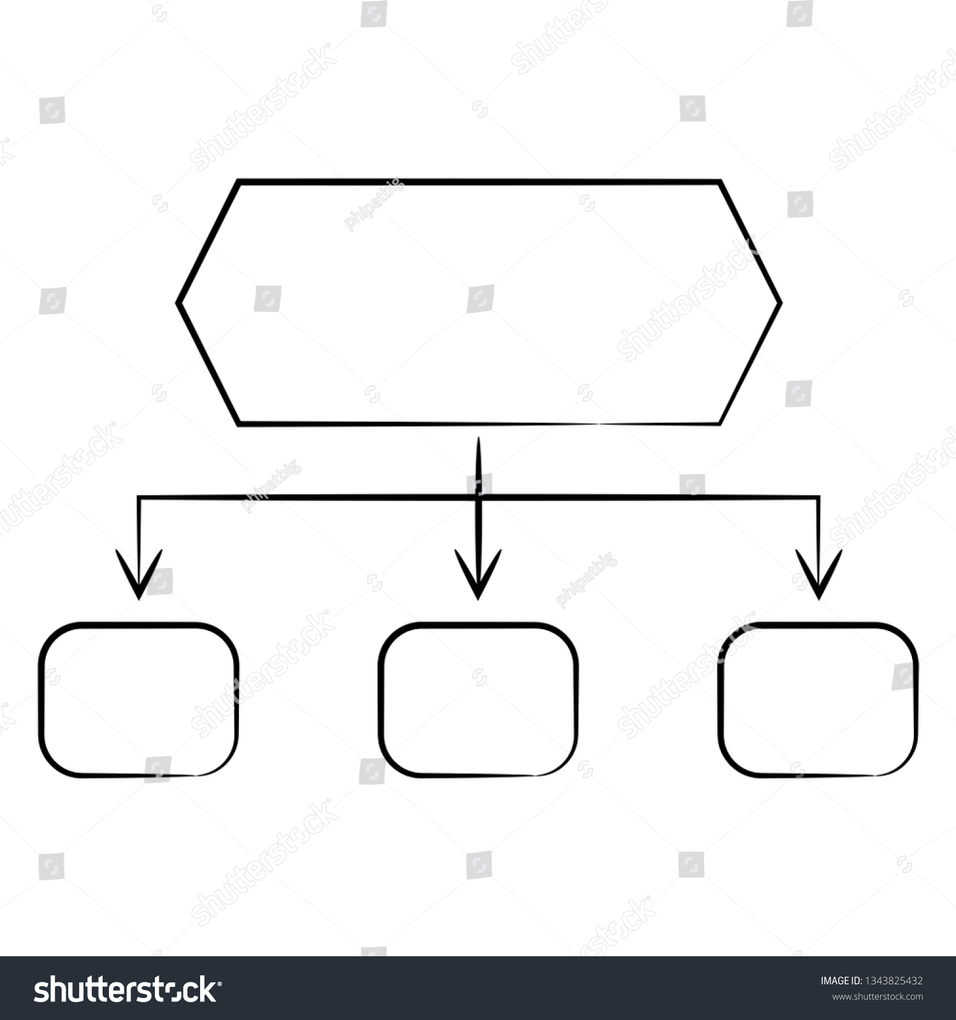
Data Set
Categorical&Numerical Data Used
ROW-614
Columns-13

Slide 5
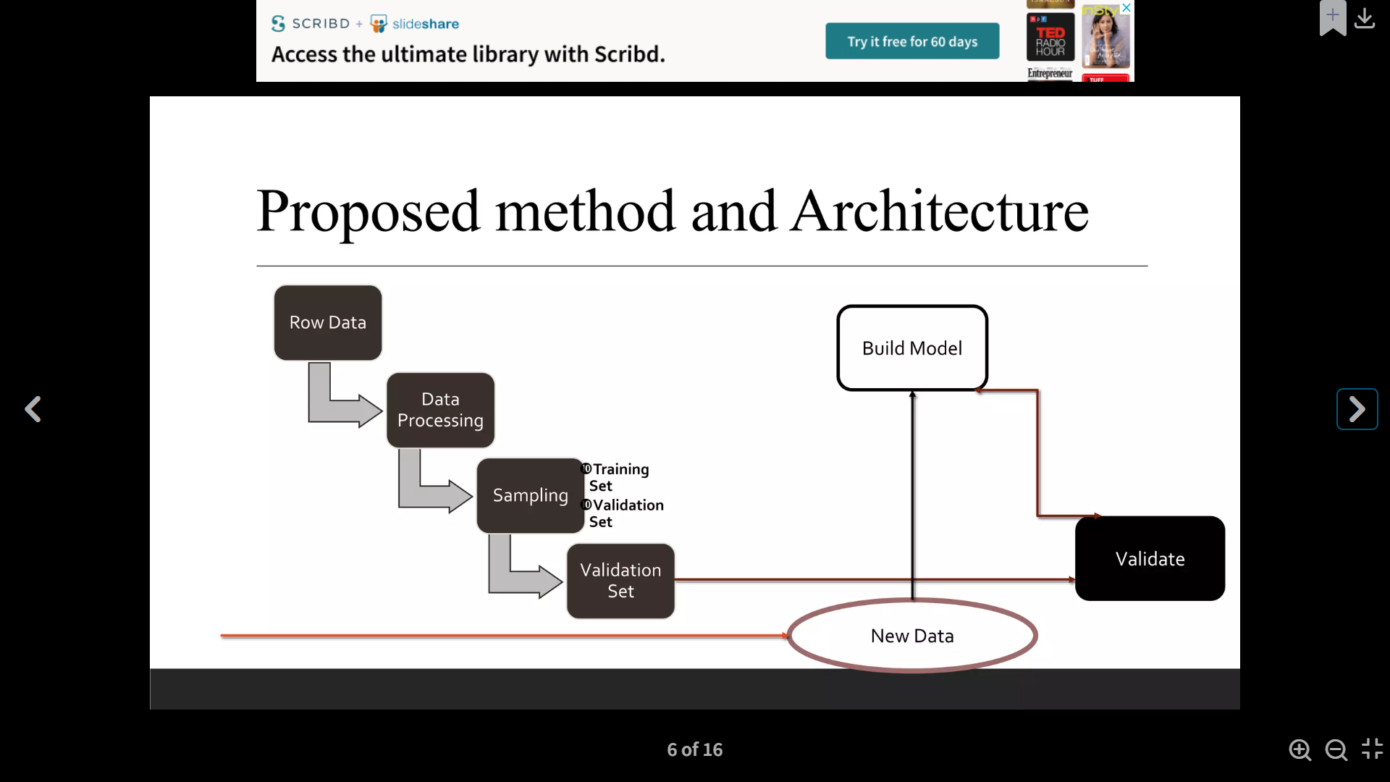

Slide 6
Architecture
Row Data: Data is Collected in the form of CSV files.
Data Processing :Processing done to join all the inpute files based on common key fields to create master table
Sampling: Processed master table is splite into Train and Test dstasets.One is to train the model and another is to validate the model
Algorithum :Logistic Regration,SVM,Decision Tree,Random Forest,is used to create clusters among clients and to classify them based on.

Slide 7
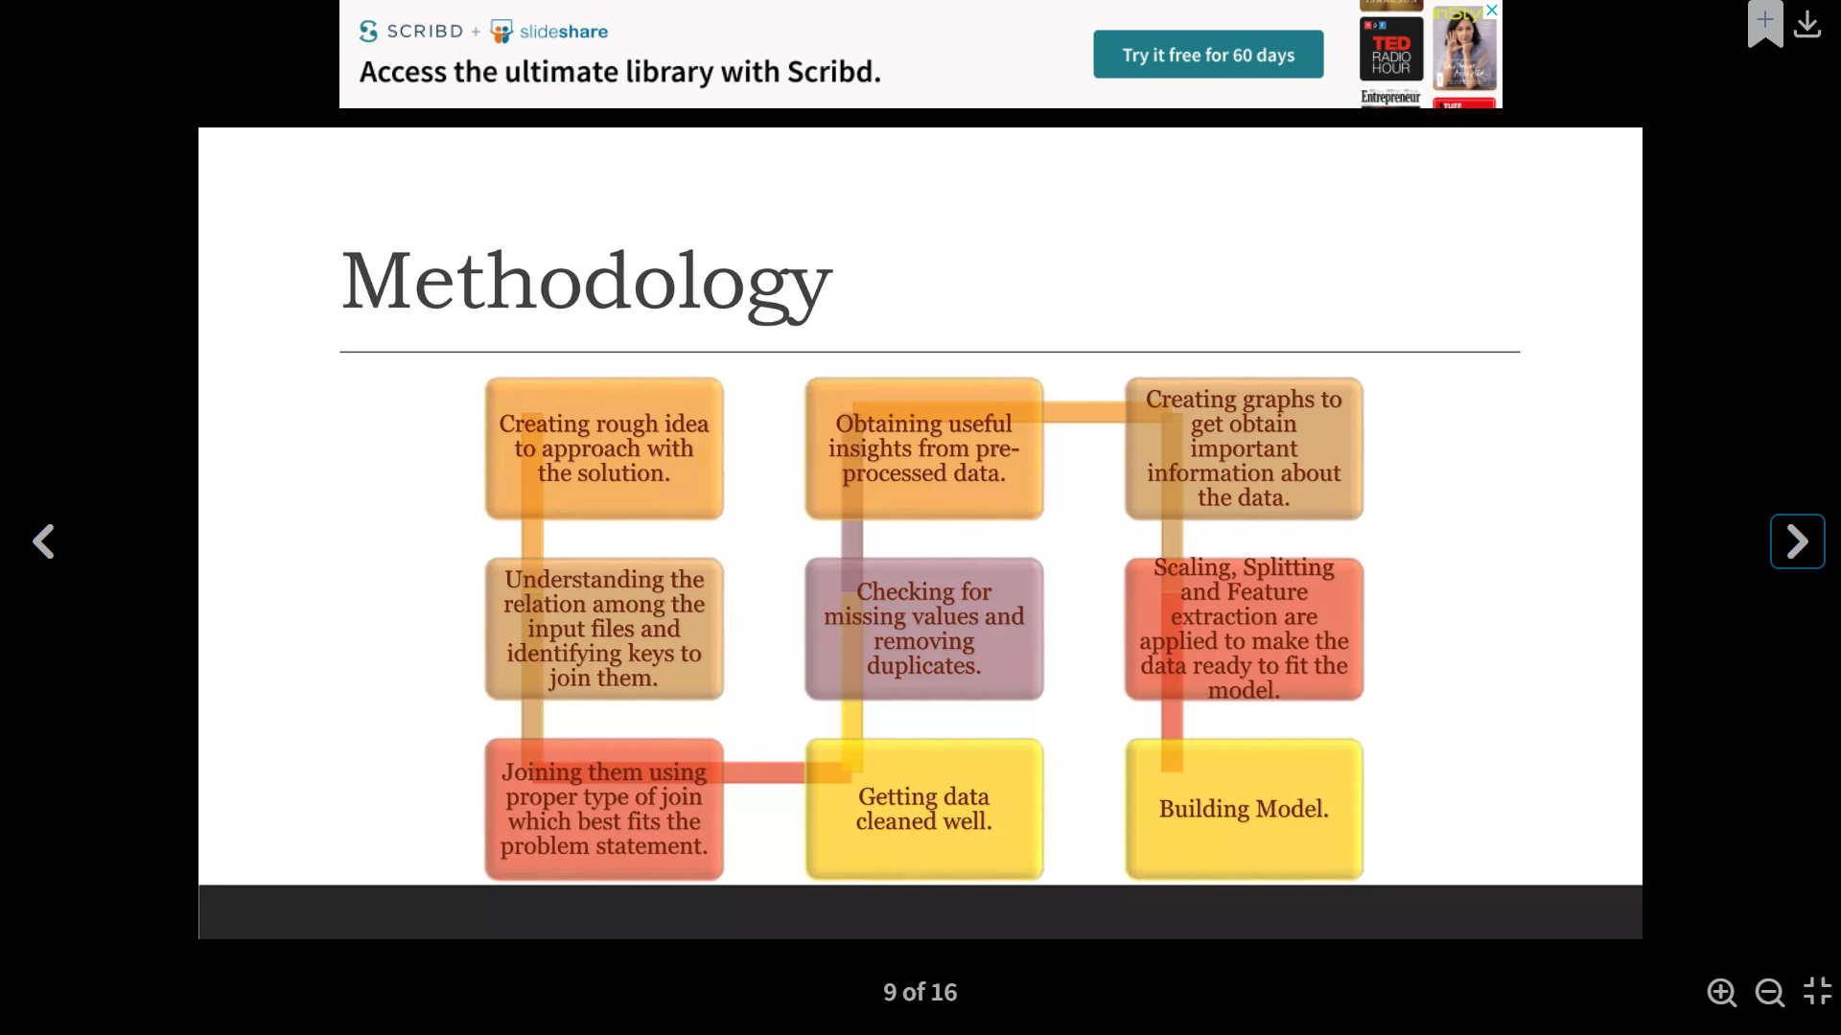

Slide 8
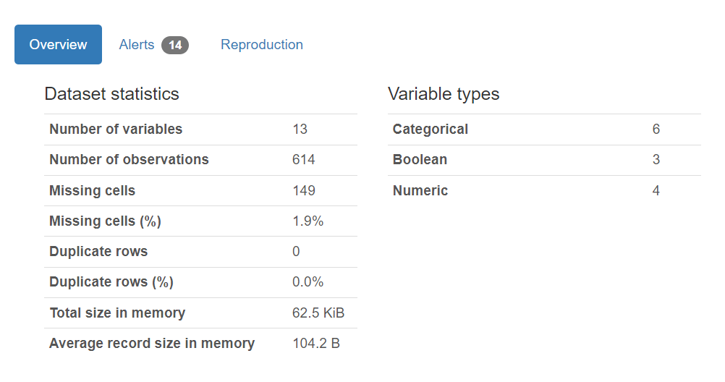
Showing The All Details On That Perticular Data Set

Slide 9
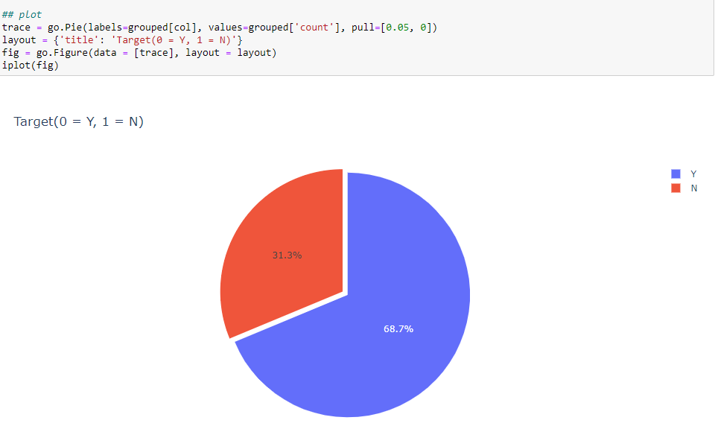
Using Pie Chart

Slide 10
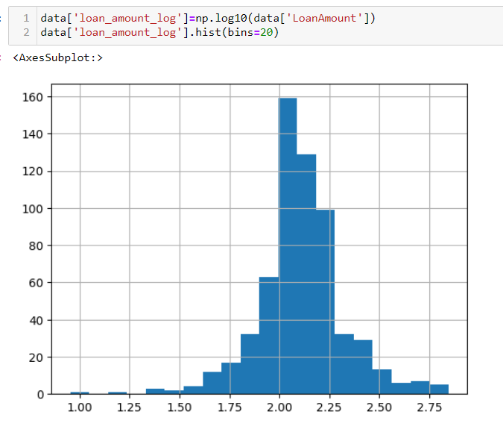
Histogram Plot
To check the Shape of The data On Histogram Plot

Slide 11
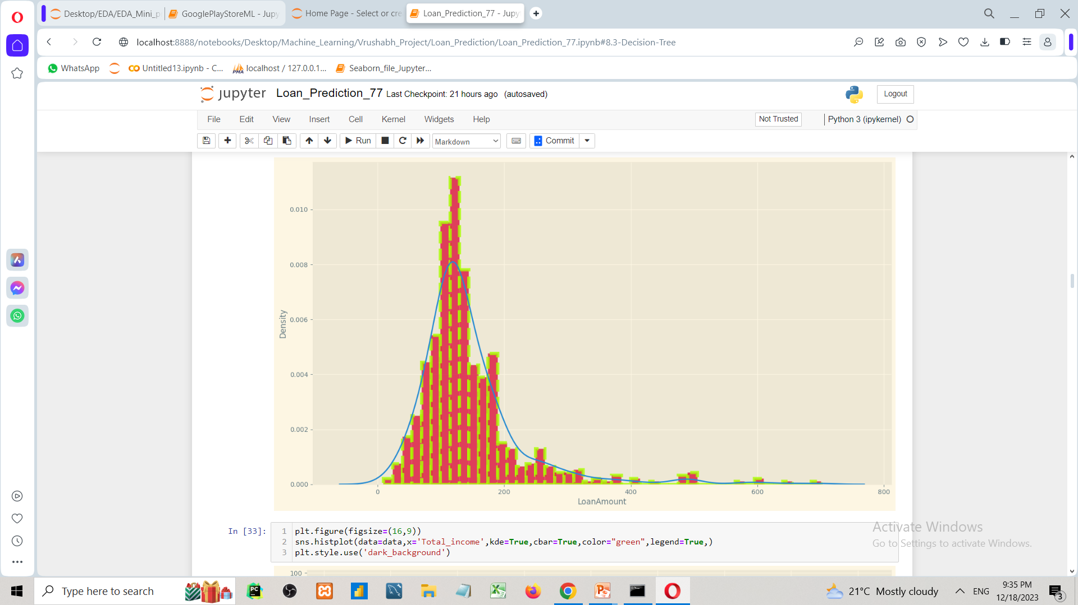
Analysis And Implement
Loan Amount vs Density
Distplot is a versatile function in the Seaborn library which is widely used for univariate data analysis. It helps you to create a histogram and Kernel Density Estimate (KDE) plot in the same visualization.

Slide 12
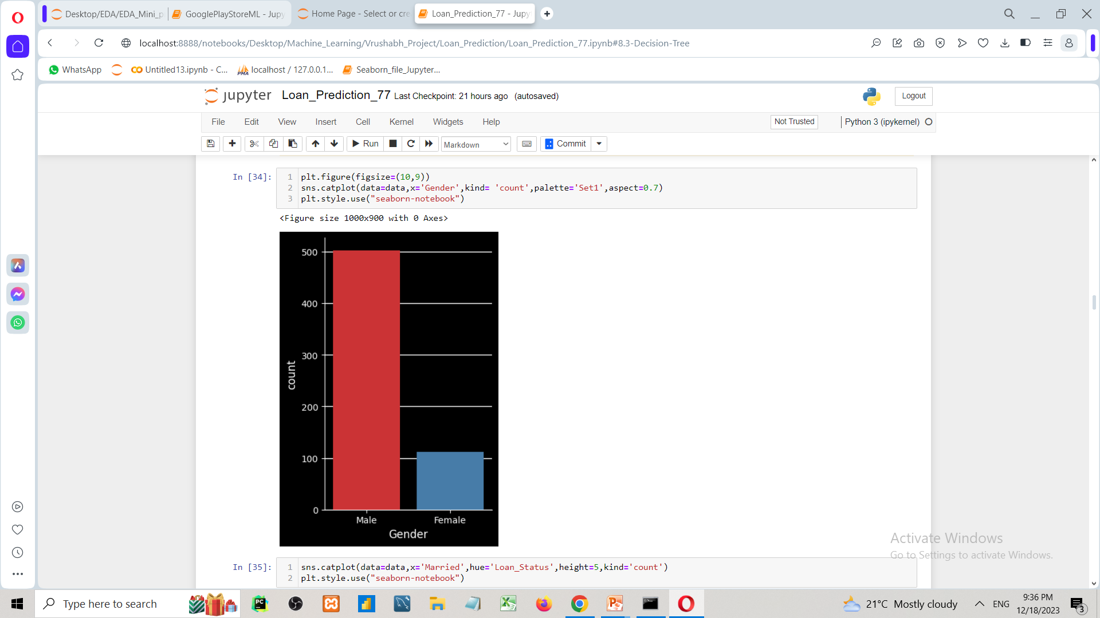
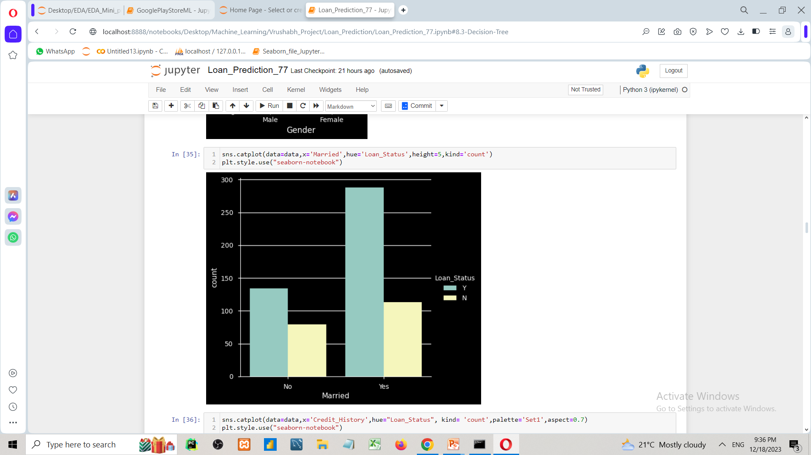
Catplot Is use to count The Unique Values On the data

Slide 13
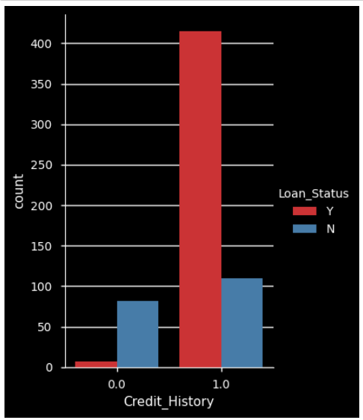
Catplot is Used to weather It is Eligible Loan for Credit History

Slide 14
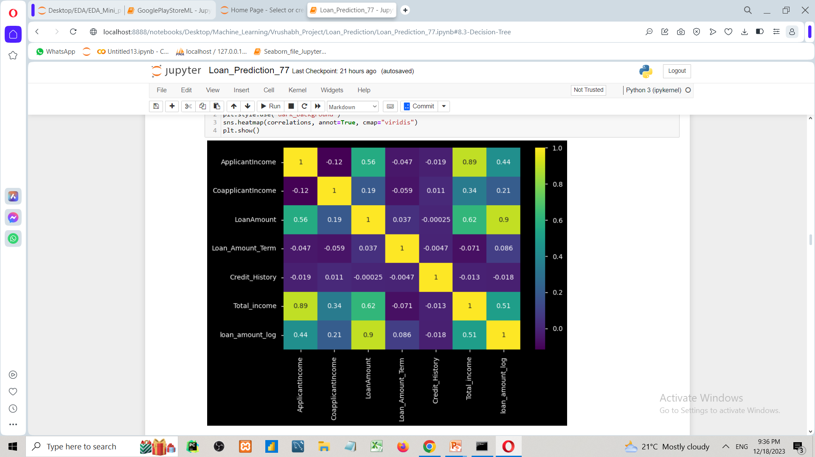
This Graph Is Showing On the Correlation On Data Set

Slide 15
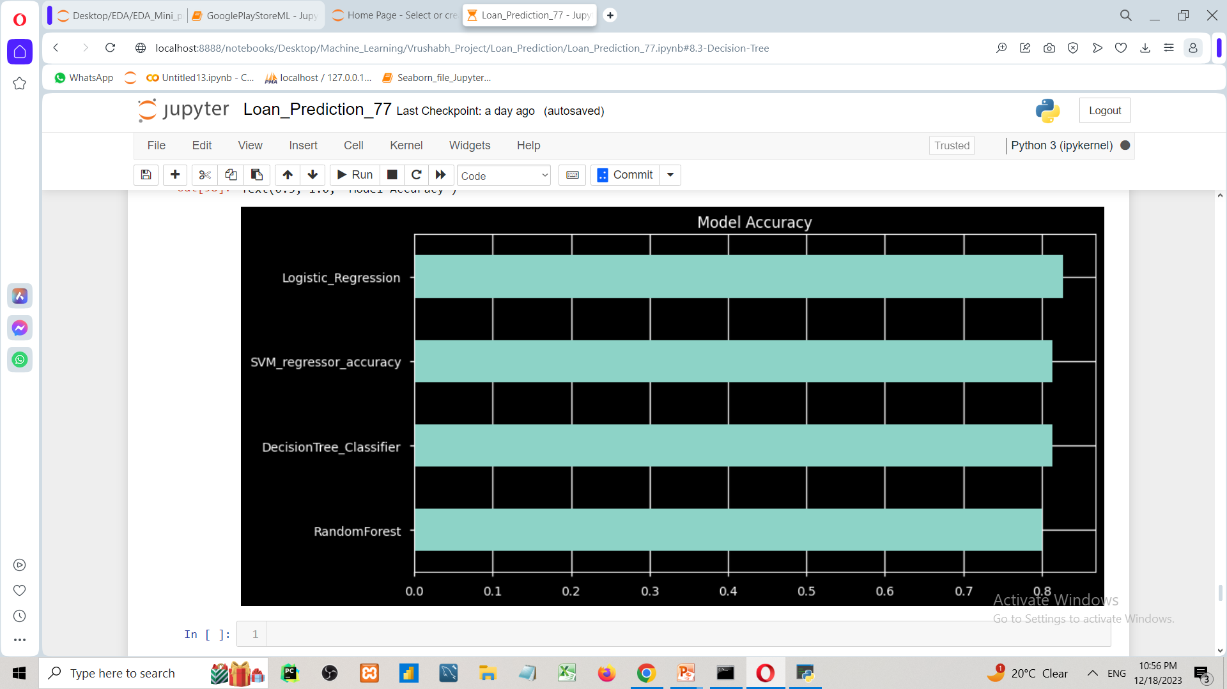
Model Accuracy
82%
82%
72%
80%

Slide 16
Summary
In this notebook we use pandas, numpy, pandas profiling for data preprocessiong and for visualization we use matplotlib, seaborn and mostly plotly. By working on the LOAN_PREDICTON data we conclude that the Loan_Amount [Approve OR Not_Approve]
Here we use different machine learning model to predict the app ratings and also compare the model performence

Slide 17
THANK YOU

